Slide 1
LA Data Observations 2021-2023

Slide 2
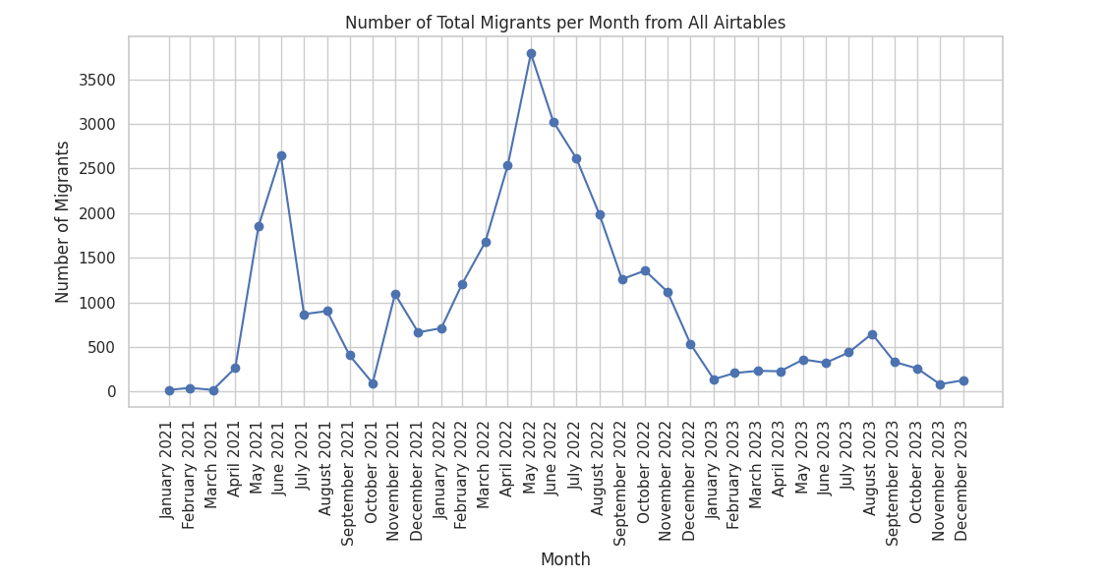
Summary
LA helped a lot of people in 2021-2023!
Total Number of people: 34073
945 People per month

Slide 3
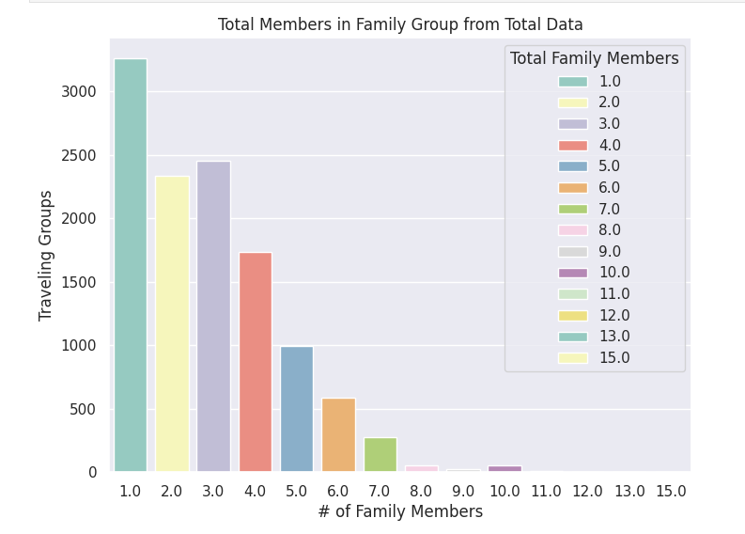
Summary
72% of parties are not single (aka are a family unit)
Average Party Size: 2.9 people per party.

Slide 4
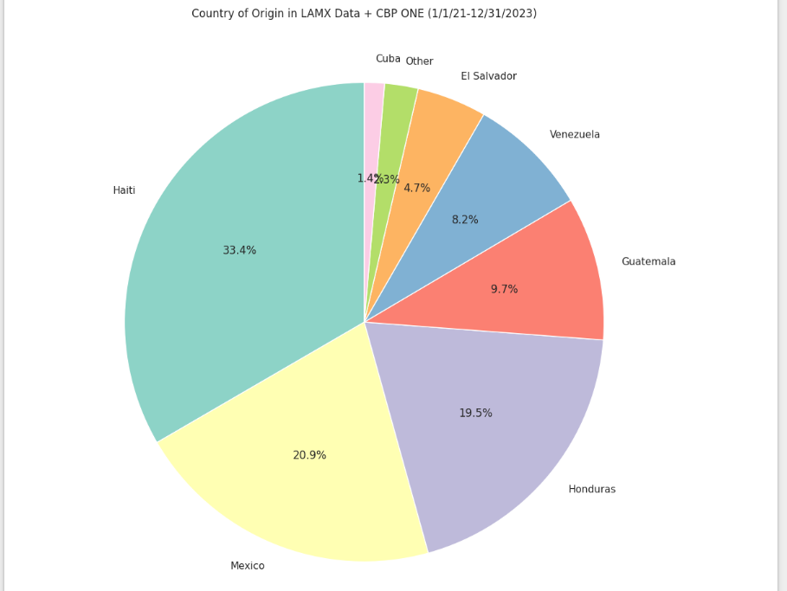
Summary
Have worked with very diverse groups of countries each with their own challenges and cultures…

Slide 5
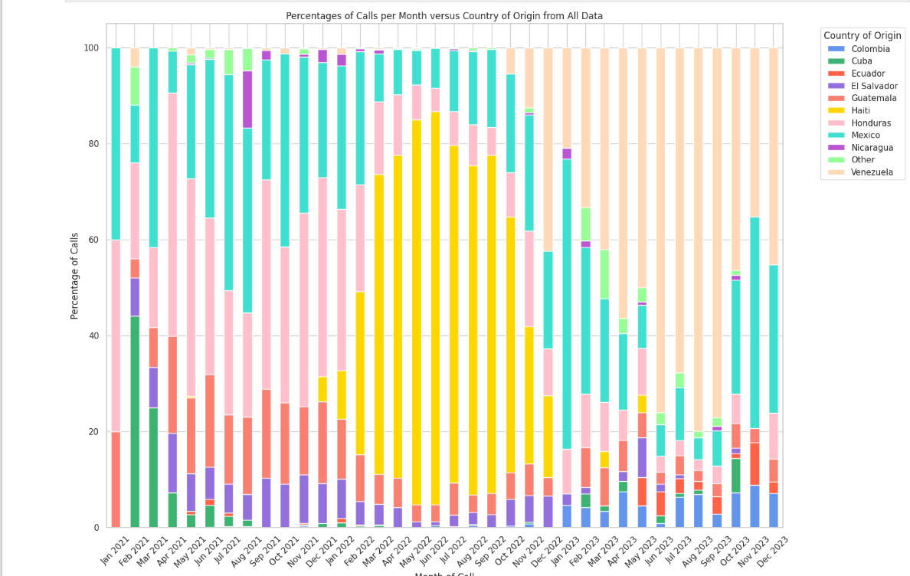
Summary
Over time we saw a lot changes – particular patterns of where people came from means we dealt with people differently
– explain challenges of Haitians (don’t speak spanish, traveled a lot, faced racism) and Venezuelans (didn’t have prior family in USA...) particular other ethnic groups/countries

Slide 6
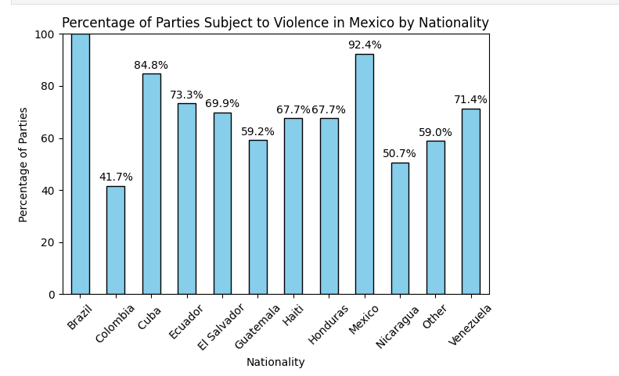
T42 Data Conclusions
Average Number of Days traveling through Mexico – 77 Days (T42 Screening Data Airtables)
“Mexico is dangerous for migrants” - 72% (LAMX Front Desk Data) report suffering some form of violence (kidnapping, robbing, death threats, GBV…) forcing them to stay there during T42 was danger to human rights.

Slide 7
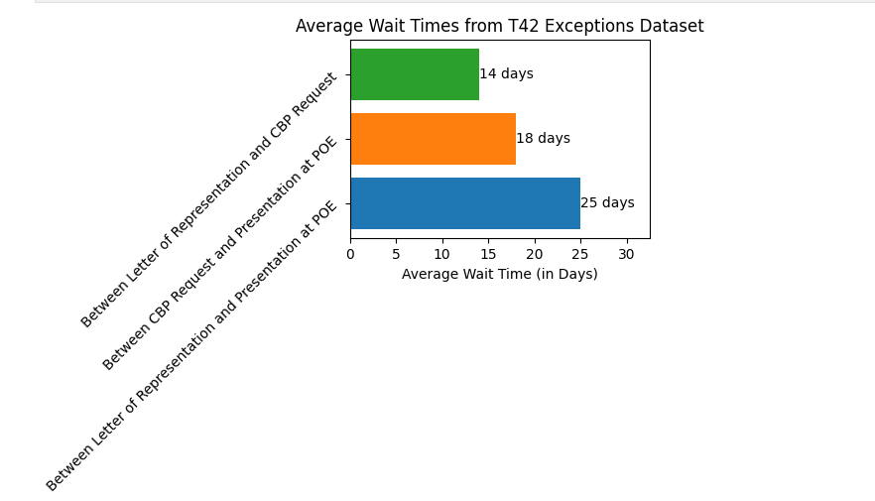
T42 CBP Wait Time
Average Wait times for people waiting in Juarez after filing CBP Request (during T42 Exceptions) and also after G28 letter of representation
Being forced to stay in Juarez on streets, or without job, income for almost a month (average) could be very dangerous and bad for human rights
Longest wait time – 134 days between G28 and Present at POE
Longest between CBP Request and Present at POE – 34 days

Slide 8
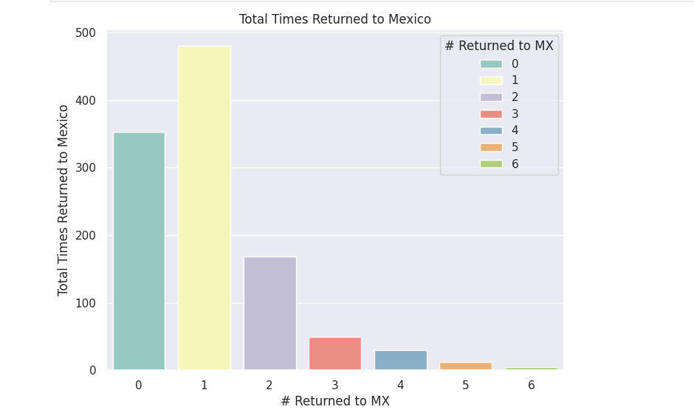
T42 CBP Wait time
These wait times often led people to be desperate – many attempts at crossing not through the port of entry.
With 102 parties being removed 3+ times (9%)
68% being removed at least once (744 parties)

Slide 9
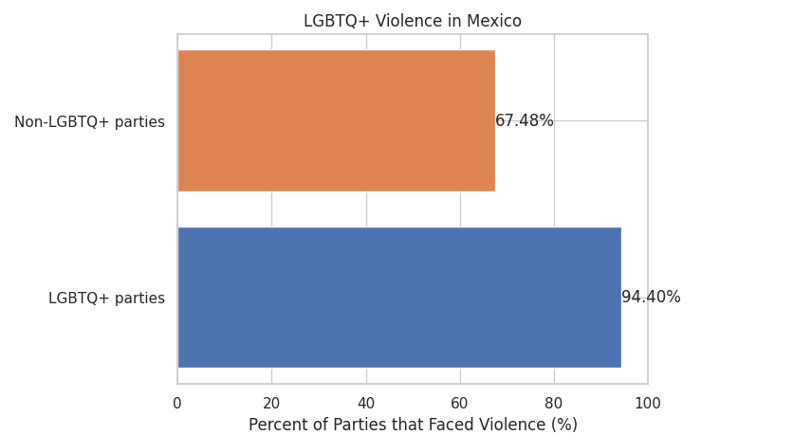
T42 LGBTQ+ Violence
LGBTQ+ people suffered violence in Mexico at a significantly higher level!!!
percentage of violence against non-LGBTQ+ parties - 67.48%
percentage of violence against LGBTQ+ parties - 94.40%

Slide 10
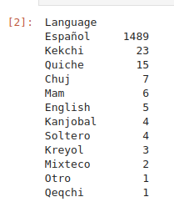
T42 - Language
Especially vulnerable are those who speak indigenous language – 1/25 parties (Kechi, Mixteco…) (From T42 Screening Airtables), routinely taken advantage of ( add some personal story here and data about if they suffer more…)

Slide 11
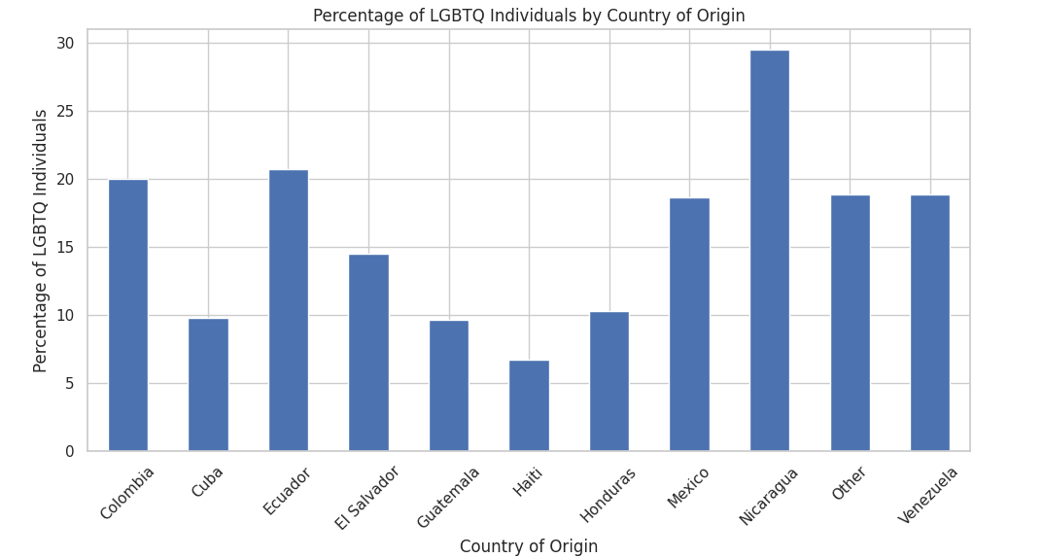
LGBTQ+ Observations
15% of all immigrant parties cite LGBTQ+ reasons for emigrating
Countries such as Nicaragua which rank low on friendliness for LGBTQ+ people have high percentage of LGBTQ+ migrants –
Subject to a lot of discrimination and crime for sexuality/gender

Slide 12
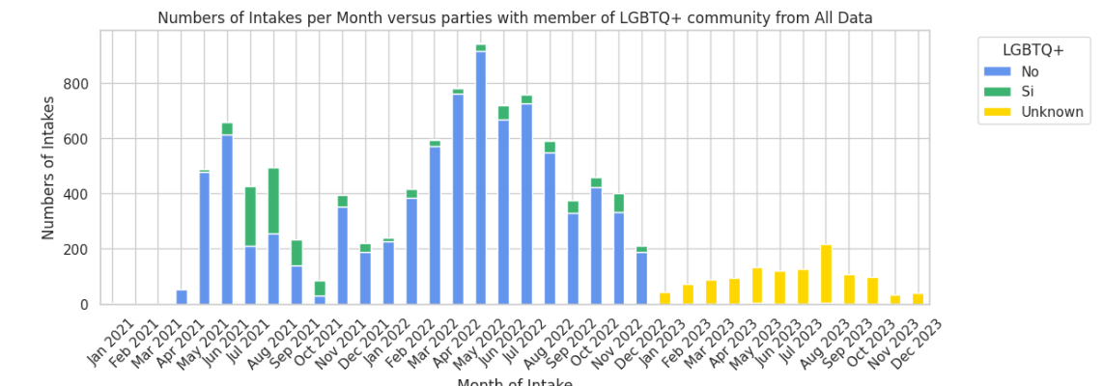
LGBTQ+ Observations
Not sure of relevance of this graph – but with Haitian migration during 2022, not many LGBTQ+ parties

Slide 13
LGBTQ+ Observations
Not sure of relevance of this graph – but with Haitian migration during 2022, not many LGBTQ+ parties

